Slide 1
Artificial Vision System for Meat Quality Gradation
B. Tech Major Project Report
By :
Debdoot Roy Chowdhury (GCECTB-R19-3014)
Arunima Chaudhuri (GCECTB-R19-3008)
Shubhodeep Chanda (GCECTB-R19-3026)
Bidesh Banerjee (GCECTB-R19-3013)
Under the Supervision of :
Kingshuk Chatterjee

Slide 2
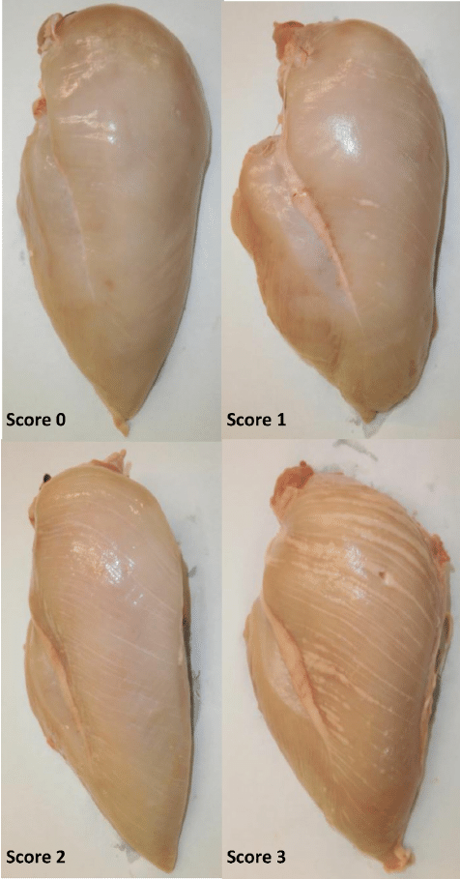
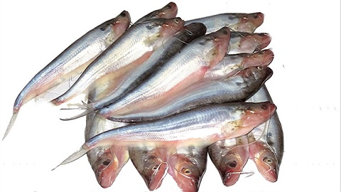
Problem statement
A rapid system for meat quality assessment is needed to guarantee the quality of meat.
We plan to solve this problem by developing a mobile application to help users determine meat freshness in real-time.

Slide 3
Importance of work
In today's world, food spoilage is a crucial problem as consuming spoiled food is harmful for consumers.
Meat is a kind of perishable food that easily decays.
As the number of meat consumers increases in the meat industry, the demand for meat supplies also rises. Determining meat freshness, therefore, is the primary consideration of the meat customers.
Due to covid, many people are ordering food items online. This has increased the necessity for real-time meat quality assessment through images.
It will be helpful for customers who don’t know how to check meat quality by seeing or touching it.

Slide 4
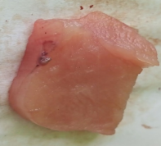
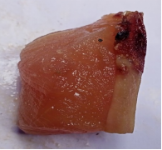
Dataset Preparation
1. Chicken
Breast meat portion was used as a sample for the dataset. The chicken breast was cut to various lengths and widths but with almost uniform thickness
The chicken meat images were captured starting from day 1 and at every 2 days' interval till 13th day. Chicken was stored in a freezer in the intermediate days with a temperature of 0 degree Celsius.
Meat images classified as consumable were taken till 5-6 days from day one of death, and meat classified as non-consumable were taken from 5-6 days of death till the 13th day.
Dataset Size -
1) Consumable - 188
2) Non Consumable - 122
Consumable
Non-Consumable

Slide 5
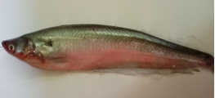
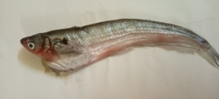
Dataset Preparation
2. Fish
The live Fish (Pabda) were sampled live from market.
The fish images were captured starting from day one of death and at every two days' interval till the 10th day. Fish was stored in a freezer in the intermediate days with a temperature of 0 degree Celsius.
Fish images classified as consumable were taken till 4-5 days from day one of death, and fish classified as non-consumable were taken from 5-6 days of death till the 10th day.
Dataset Size -
1) Consumable - 60
2) Non Consumable - 80
Consumable
Non-Consumable

Slide 6
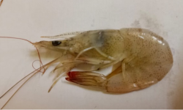
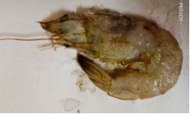
Dataset Preparation
3. Prawn
Fresh white-leg prawn were sampled live from market.
The prawn images were captured starting from day one of purchase and at every one day interval till 7th day. It was stored in a freezer in the intermediate days with a temperature of 0 degree Celsius.
Images classified as consumable were taken till 3-4 days from the day one of death, and images classified as non-consumable were taken from 3-4 days of death till the 7th day.
Dataset Size -
1) Consumable - 52
2) Non Consumable - 70
Consumable
Non-Consumable

Slide 7

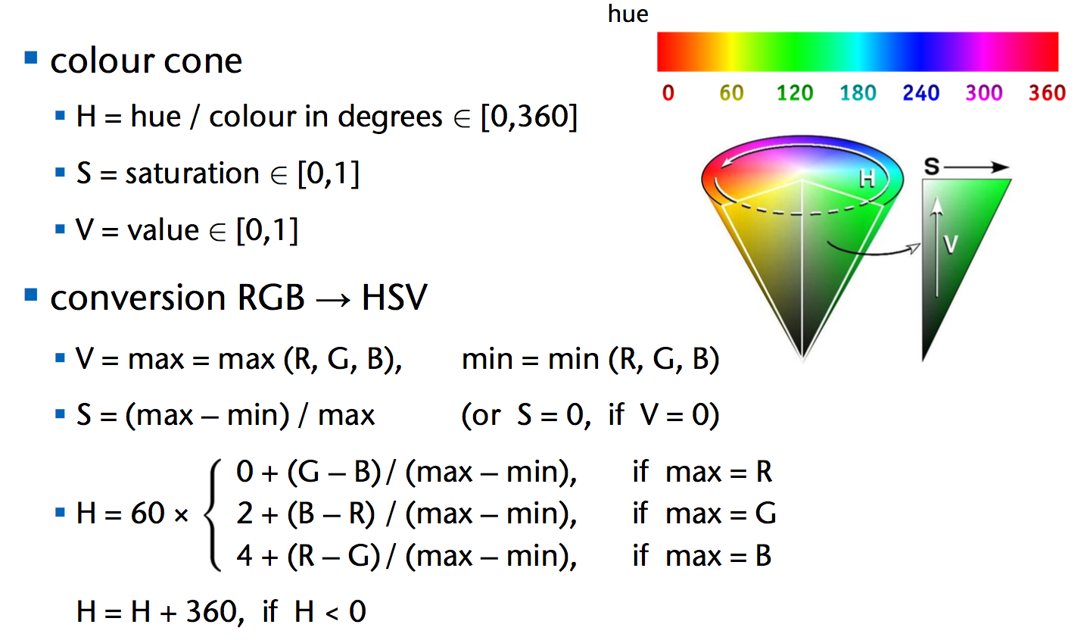
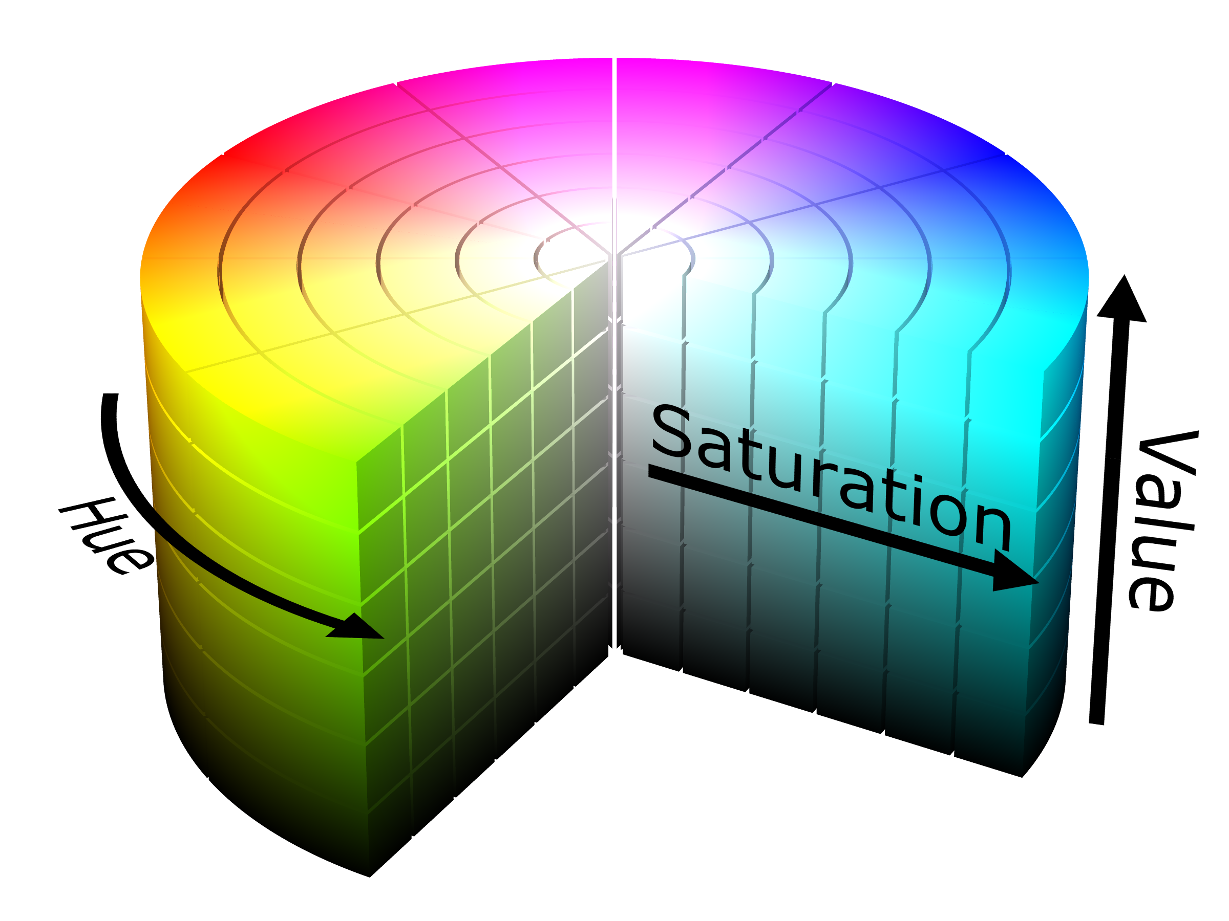
Methodology
1. Color Spaces
RGB (Red, Green, Blue)
HSV (Hue, Saturation, Value)

Slide 8
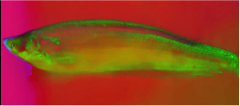
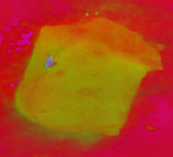
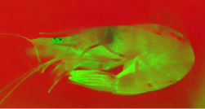
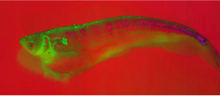
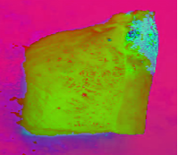
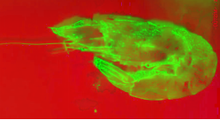
Methodology
1. Color Spaces
The use of HSV rather than RGB space is beneficial in texture analysis. Paschos [7] demonstrates that perceptually uniform spaces, such as HSV, outperform non-uniform RGB.
Consumable (HSV)
Consumable (HSV)
Consumable (HSV)
Non - Consumable (HSV)
Non - Consumable (HSV)
Non - Consumable (HSV)

Slide 9
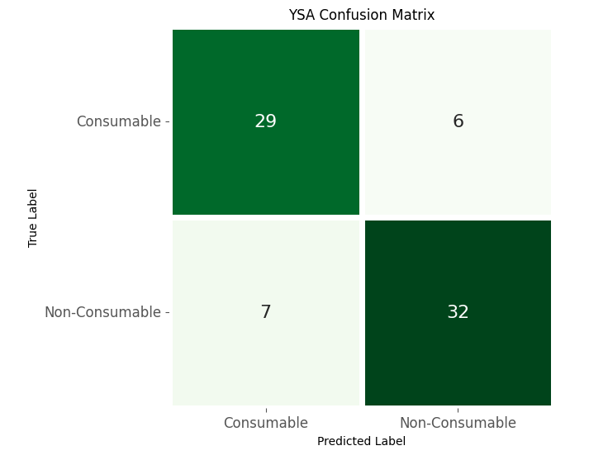
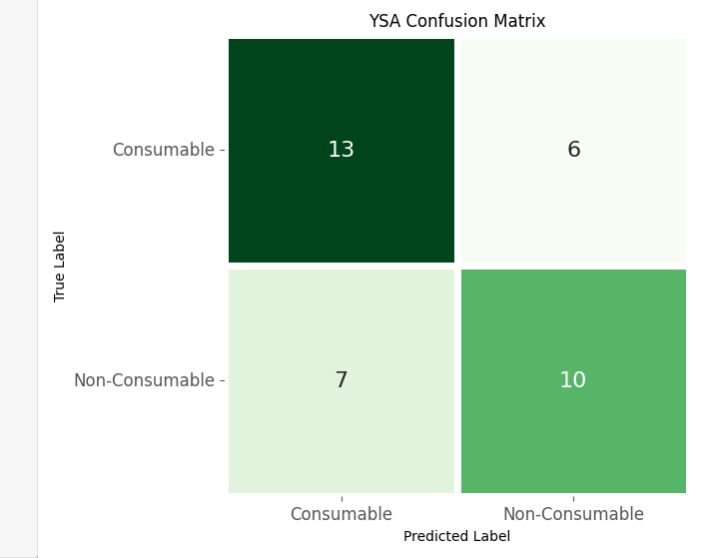
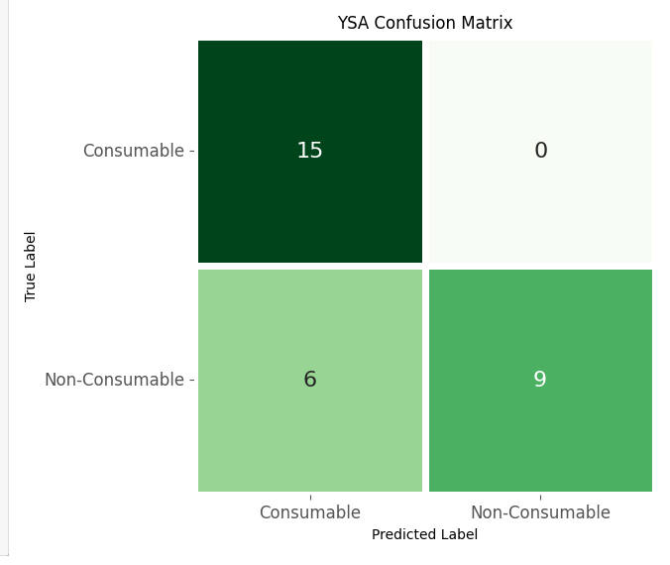
Methodology
2. Deep Learning Methods
Neural Network (Tensorflow)
When we pass the dataset in this model we can see that Chicken and Prawn equally provided good results under this method mainly in HSV color spaces. Fish gave somewhat intermediate accuracy in HSV Color space.
Chicken Dataset (HSV)
Fish Dataset (HSV)
Prawn Dataset (HSV)

Slide 10
App Development
An android app is developed using Flutter SDK to implement the previously discussed deep learning model.
Above discussed Tensorflow model is first converted to a Tensorflow Lite model, which is then used as the computation model for the app.
TensorFlow Lite is a set of tools that enables on-device machine learning by helping developers run their models on mobile, embedded, and edge devices.
Images can be uploaded to the app from Gallery or File Manager, and the app will predict the type of meat along with the quality of the meat as Consumable or Non-Consumable within seconds.

Slide 11
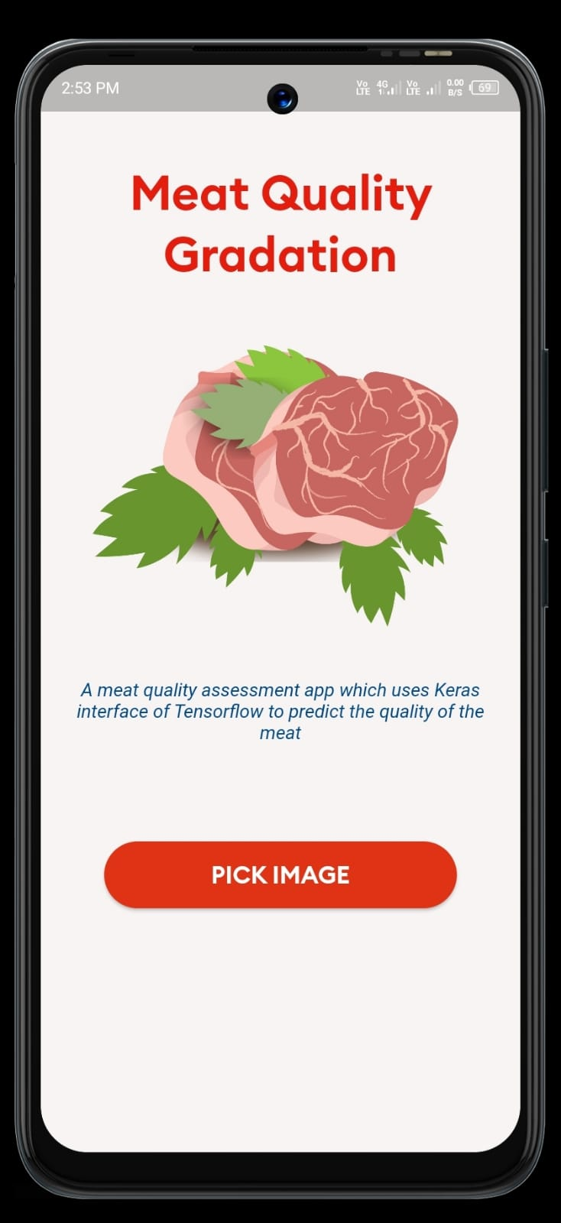
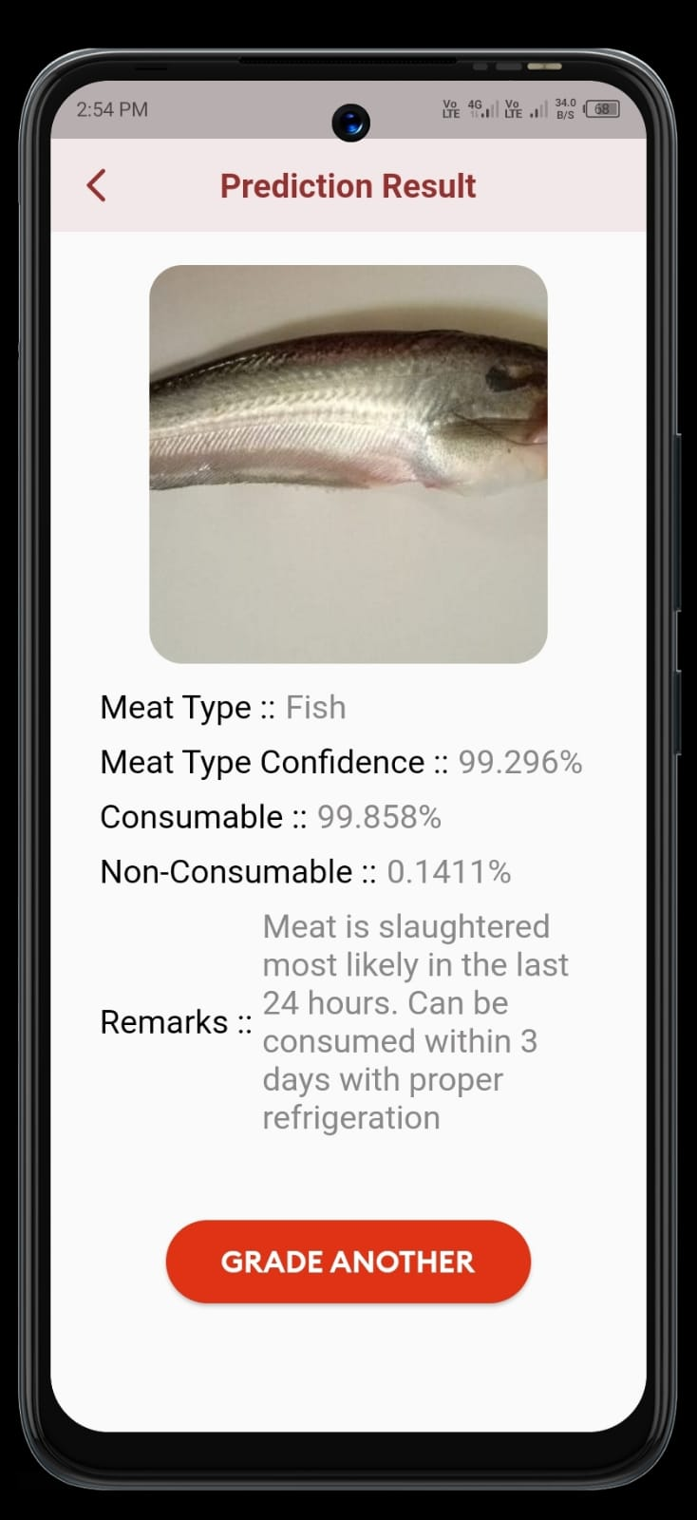
App Interface

Slide 12
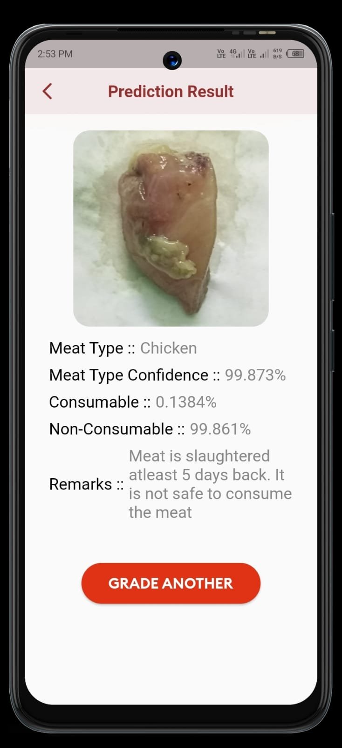
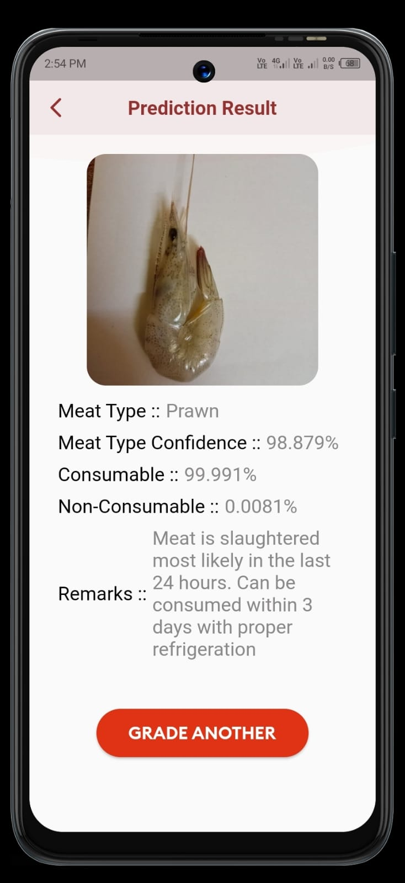
App Interface

Slide 13
Results
The experiment was to build a mobile application which predicts the freshness of meat on a given color space very fast.
The results show that an app using image classifications can be used to classify good (consumable) and bad (non-consumable) meat.
One of the important results was quality of image and color space played a vital role in predicting the quality of meat.
The biggest strength of the study was that the deep learning model used in the app does very minimal computations, which makes the app good for even low-end devices.
For some images, which are captured in low lights the model produced inaccurate results.

Slide 14
Conclusion
We observed for all the datasets and Deep Learning HSV color space gave better accuracy than RGB color space.
Deep learning models used for the above problem for each of the dataset some particular models provided better accuracy than the others.
To conclude, artificial vision and deep learning is a reliable technique, and it has shown its efficiency in many applications related to meat assessment.

Slide 15
Future Work
Option for uploading pictures using Camera will be added to the app.
Optimization of the existing models will be done, to provide better results for far more wide instances of those datasets.
Addition to that we will try more complex deep learning models for better accuracy.
Model will be chosen accordingly for further experimentation, keeping in mind the computational complexity and the platform in which the project will be implemented.

Slide 16
References
Chernov, Vladimir, Jarmo Alander, and Vladimir Bochko. "Integer-based accurate conversion between RGB and HSV color spaces." Computers & Electrical Engineering 46 (2015): 328-337.
Kumar, Tarun, and Karun Verma. "A Theory Based on Conversion of RGB image to Gray image." International Journal of Computer Applications 7.2 (2010): 7-10.
Kralik, Gordana, et al. "Quality of chicken meat." Animal husbandry and nutrition 63 (2018).
Huss, Hans Henrik. Fresh fish--quality and quality changes: a training manual prepared for the FAO/DANIDA Training Programme on Fish Technology and Quality Control. No. 29. Food & Agriculture Org., 1988.
Wijaya, Dedy Rahman, Riyanarto Sarno, and Aldhiaz Fathra Daiva. "Electronic nose for classifying beef and pork using Naïve Bayes." 2017 International Seminar on Sensors, Instrumentation, Measurement and Metrology (ISSIMM). IEEE, 2017.
Adi, Kusworo, et al. "Beef quality identification using color analysis and k-nearest neighbor classification." 2015 4th International Conference on Instrumentation, Communications, Information Technology, and Biomedical Engineering (ICICI-BME). IEEE, 2015.

Slide 17
References
7. Cortez, Paulo, et al. "Lamb meat quality assessment by support vector machines." Neural Processing Letters 24.1 (2006): 41-51.
8. Astuti, Suryani Dyah, et al. "Gas sensor array to classify the chicken meat with E. coli contaminant by using random forest and support vector machine." Biosensors and Bioelectronics: X 9 (2021): 100083.

